Slide 1
Introduction MPF® University
“MPF” is a registered trademark of the Federal Home Loan Bank of Chicago and the “MPF Mortgage Partnership Finance” logo is a trademark of the Federal Home Loan Bank of Chicago.
Notes:
Thank you for taking the time to view this brief presentation on MPF University. This session will provide general instructions for setting up your MPF University account and an easy to follow tour of the site.

Slide 2
What is MPF University?
MPF University is a free, on-demand learning tool that provides approximately 140 industry-related courses.
MPF University contains courses designed by the Mortgage Bankers Association (MBA).
Increase your industry knowledge.
Meet or create educational goals.
A great resource for new employee onboarding.
Notes:
For a number of years now, MPF National Education has managed a free, on-demand learning site for our PFIs called MPF University. MPF University houses roughly 140 courses that are provided by the Mortgage Bankers Association . In addition to using MPF University to increase your personal learning goals, we have heard from organizations who use it for annual educational goals and as a part of their new employee training curriculum.. Let’s continue on with how to set up your MPF University account so you can get started.

Slide 3
Getting Started
If an option, use CHROME as your browser!
Visit www.fhlbmpf.com
Click on the Education link and drop down to MPF University.
Notes:
Setting up your account in MPF University is easy. One important thing to note is that if it’s available to you, you should use Chrome as your browser. Some issues have been identified for those who use internet explorer. The MPF University account set up page is located on the mpf website, fhlbmpf.com
From the MPF Program homepage, click on the Education tab that you see circled on this slide. Clicking the link will bring up a dropdown list that includes an option for MPF University.

Slide 4
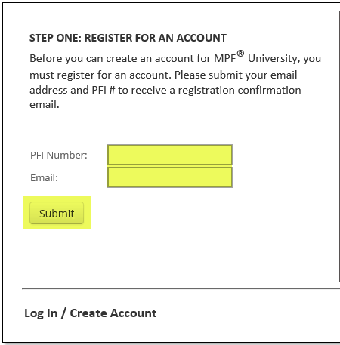
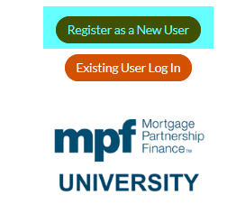
Click on Register as a New User.
Enter your PFI Number and enter your email address.
Click Submit.
Notes:
The MPF University page on the MPF Program website is where you will begin to create your account. Step number one is to click on the Register as a New User link. This will bring up a box that allows you to register for a new account. Enter your PFI Number and enter your email address. Click Submit.

Slide 5
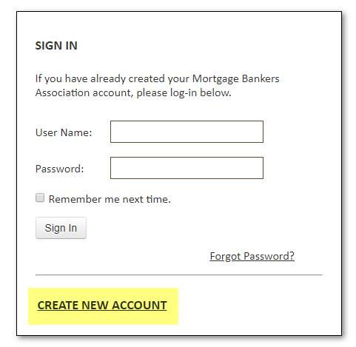
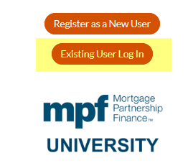
After submitting, you should receive an email confirmation. You do not need the email to finish your account set up.
Click on the Existing User Log In button and click on the link to CREATE NEW ACCOUNT.
Notes:
After clicking submit, you should receive a system generated email acknowledging your account. If for some reason you do not receive the email it won’t prevent you from setting up your account. Simply return to the MPF University page on the MPF website, click on the Existing User Log In button. At the bottom of the login box click on the Create New Account link. By the way, the Existing New User link on the MPF University page is where you go to log into MPF University once you have your account set up.

Slide 6
To begin your account set-up, enter your email address and click Continue.
If you already have a log-in with the MBA, you’ll receive a message. If not, it will prompt you to continue setting up your account.
If you already have an MBA account, you
may use it to access MPF University.
If when logged in the courses do not appear under
your account, contact MPFUniversity@fhlbc.com.
Notes:
To begin your account set up, enter your email address into both fields and click continue. It’s at this point that you may be notified that you already have an MBA account. If that happens, you’ll see the box that is shown on the right hand side of this slide. If you don’t remember your existing MBA password, follow the link to reset your password. Your existing MBA credentials should give you access to MPF University. If it’s been determined that you do not have an existing MBA account, you will be prompted to complete additional fields which includes setting up your account password.

Slide 7
Continue completing the account set-up fields.
Read the password requirements carefully before attempting to create your password!
10. Select the Federal Home Loan Bank of Chicago as your Company Affiliation.
Let’s take a look at the site…
Notes:
As you complete the required account set up fields, we’d like to remind you that the password requirements are very specific. Please read through them carefully to avoid frustrating password creation error messages. Once your account and login credentials established, you are ready to access MPF University. You can log in as an existing user on the MPF University landing page.

Slide 8
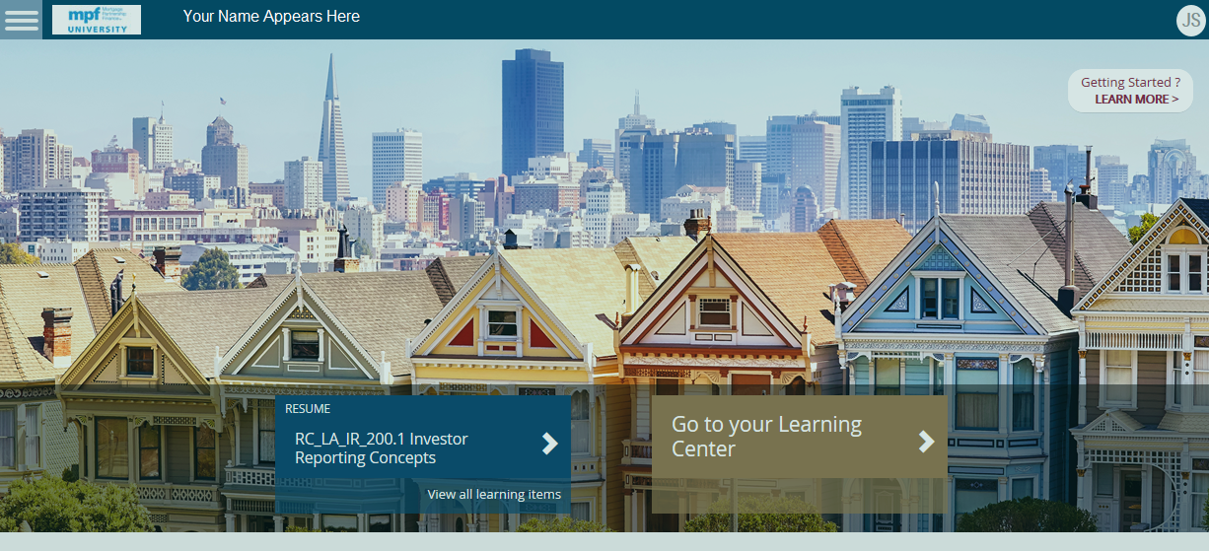
MPF University Homepage
Notes:
Once you are logged into MPF University you should see this landing page. The first thing to look for is the MPF University logo at the upper left hand corner of your screen. If you see the MBA logo, send an email to the MPF University mailbox, MPF University at fhlbc.com. The link to this email address is located on the MPF University login page.
There are two main options on the homepage. The First option allows you to resume a course that you may have in progress.
The second box will take you to the learning center page which will show you a list of available courses and any courses you have enrolled in. It will also show you the courses that have been started but not completed just like the blue resume box to the left. Since it shows just about everything, we’ll move on to the learning center page to give you an idea of how it’s laid out.

Slide 9
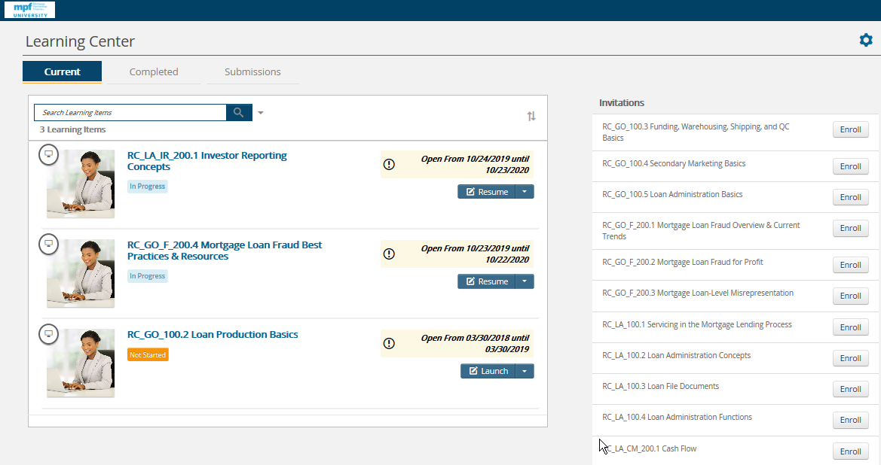
The Learning Center page shows enrolled courses, courses in progress and a list of all available courses.
Notes:
As mentioned you will see all of the courses you have started but haven’t finished and any courses you have enrolled in but haven’t started. Simply click on resume or continue where you left off or launch to begin an enrolled course.
On the right hand side of the page you will see a list of available courses. There is a scroll bar to allow you to view the complete list of 140 courses. If you’d like to enroll in a course, click on enroll button to move the offering to the list on the left side of the page. Just a note about the courses on your enrollment list, if you change your mind, there current isn’t a way for users to remove courses from their enrollment list. Courses that are not completed or started will stay on your list for a period of time until they are eventually removed by the MBA site administrators.

Slide 10
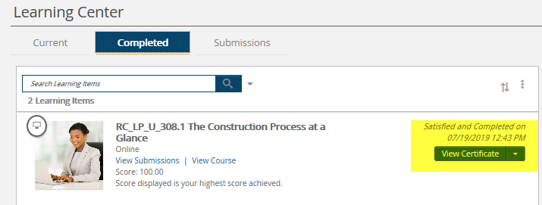
Certificates of Completion are available after each successful course completion.
Notes:
Many of the MPF University offerings include a short post-course exam that must be passed before credit for the course is given. Once a passing score is obtained, a Certificate of Completion will be available. To view your certificates, click on the Completed tab located on the learning center page. All completed courses and certificates will be listed. You can print or save a copy of your certificates as evidence of reaching your STI goal.

Slide 11
Questions?
If you have any questions or experience any difficulty setting up your MPF University account, contact:
mpfuniversity@fhlbc.com
Notes:
If you have any questions about establishing your MPF University account, please reach out to MPF National Education a mpfuniversity!fhlbc.com. Thank you for your time and happy learning!

